Slide 1


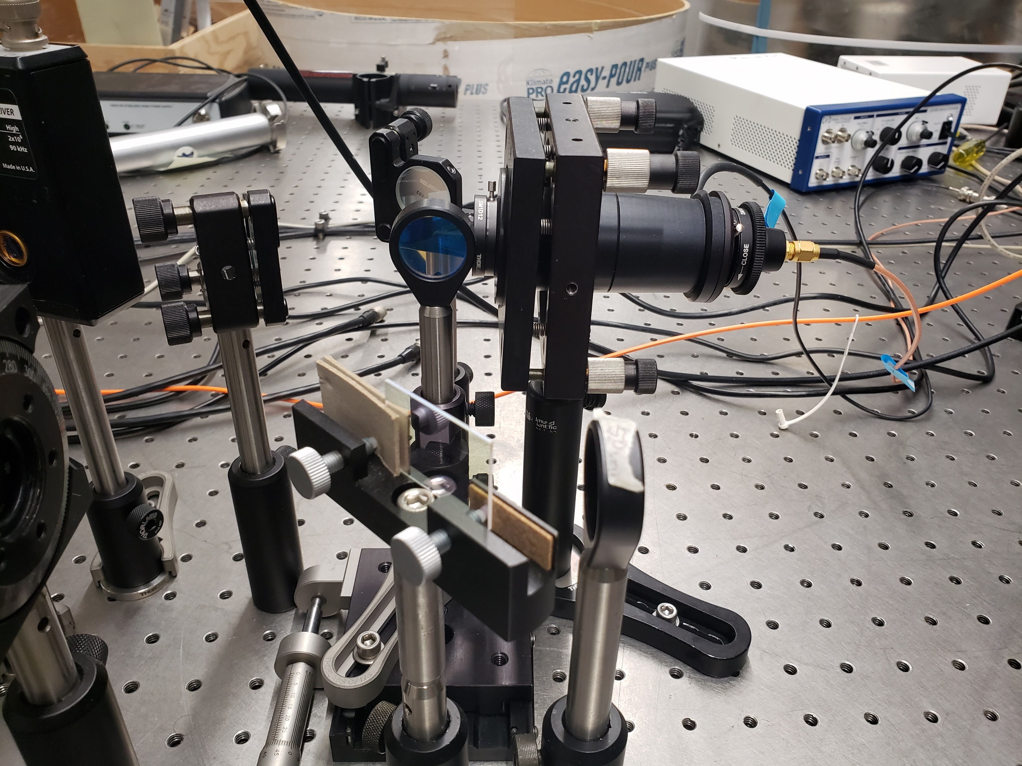
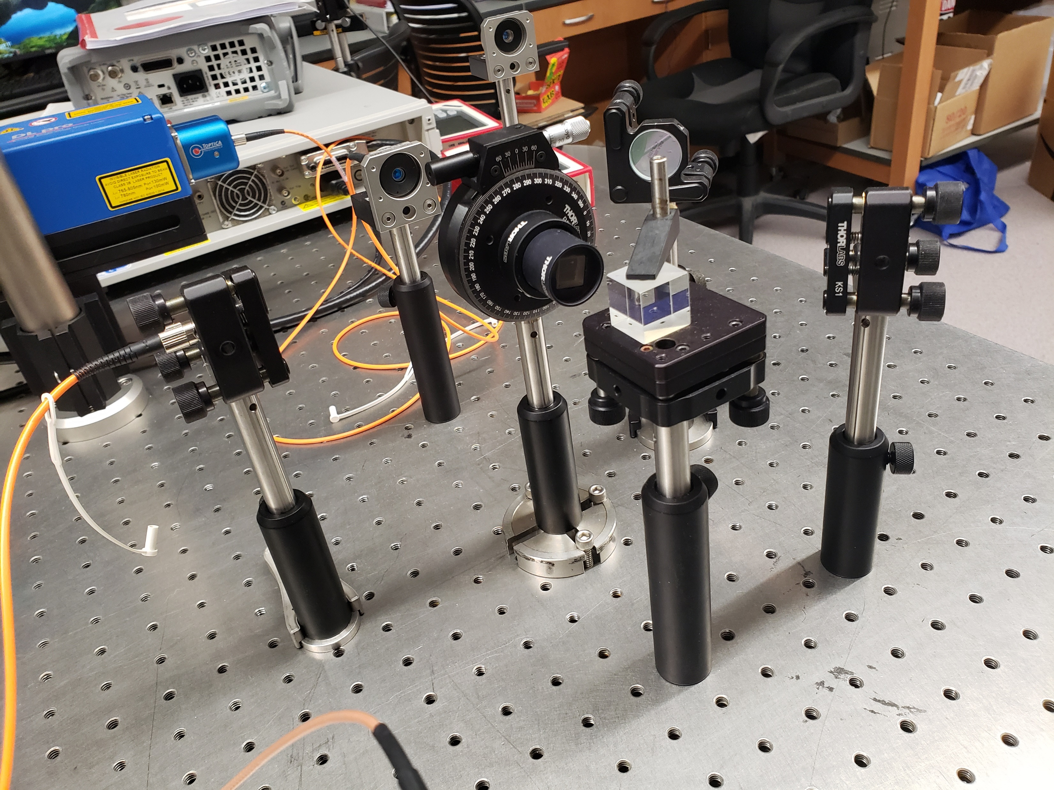
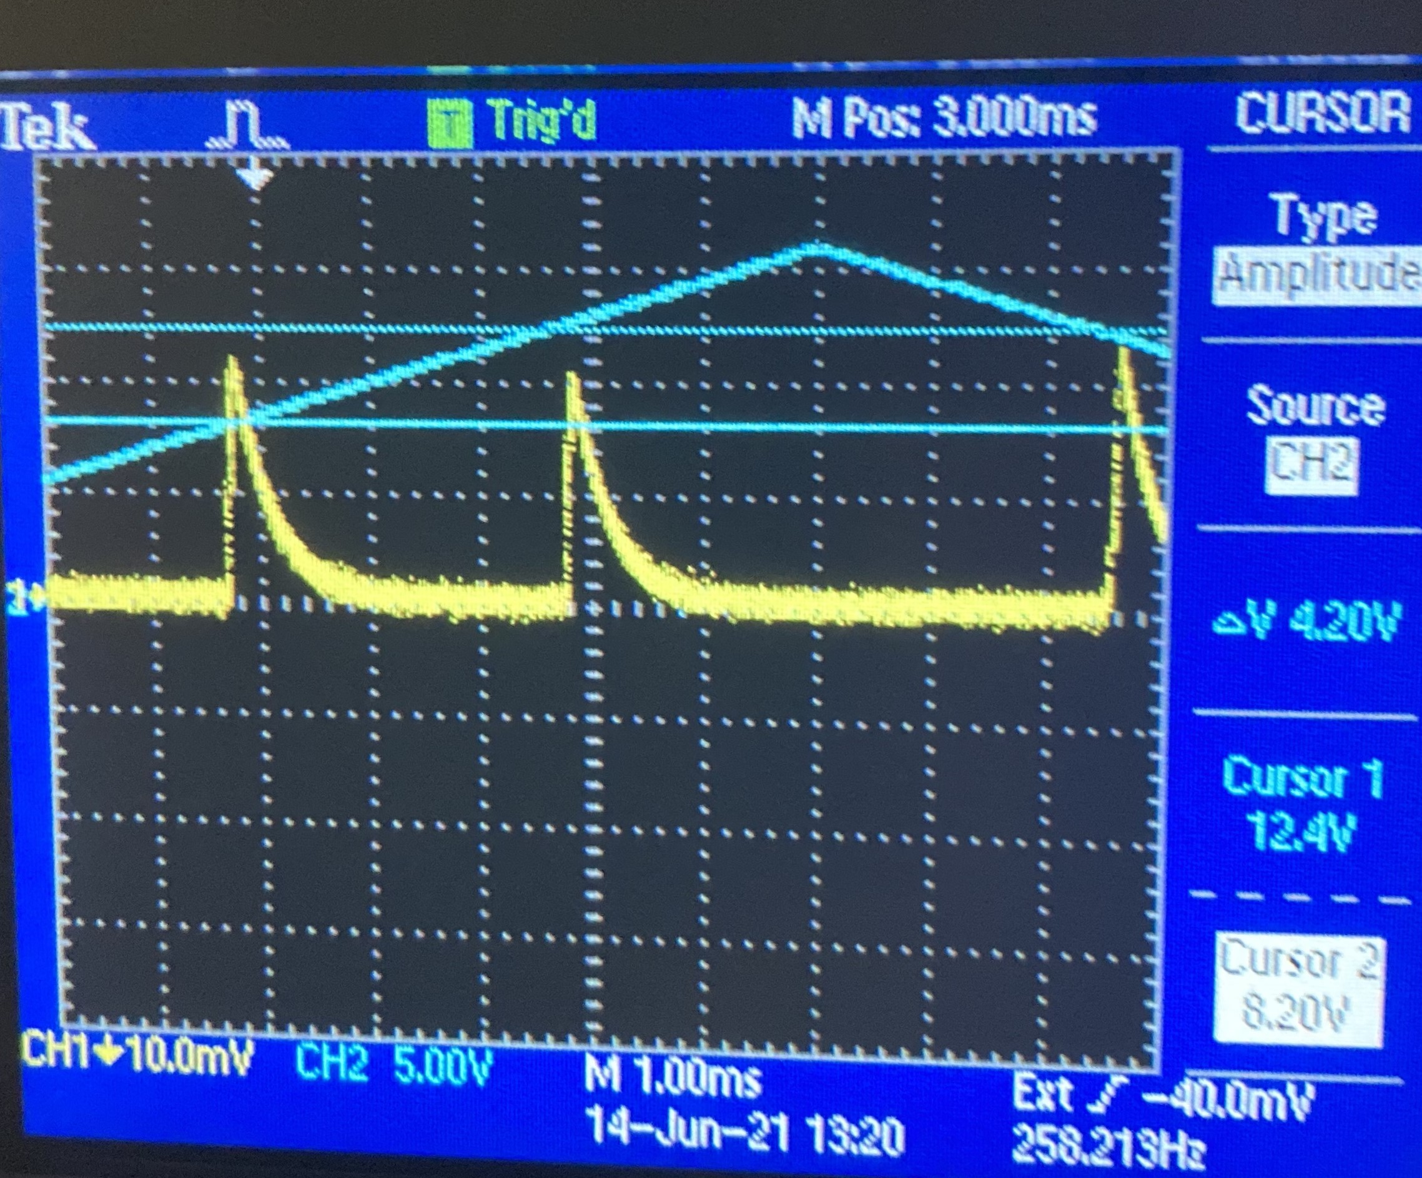
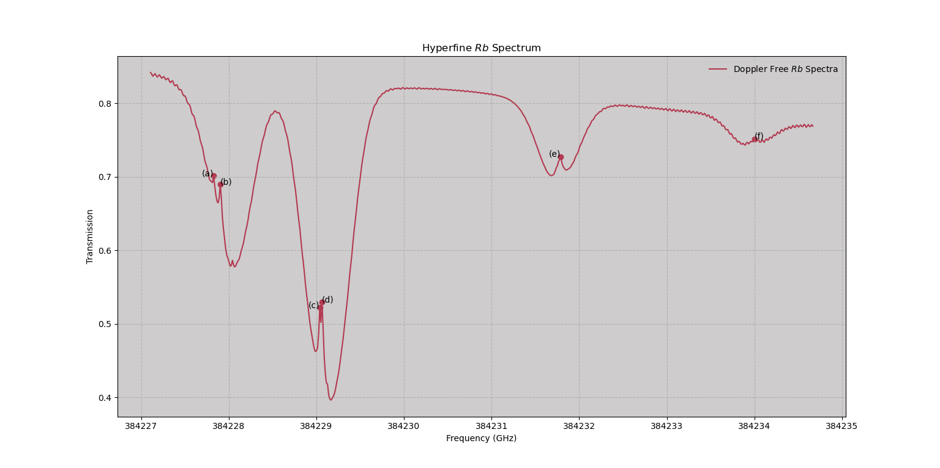
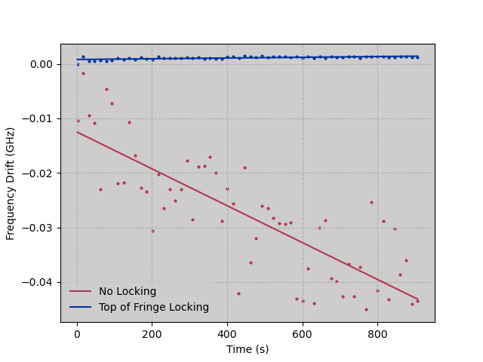
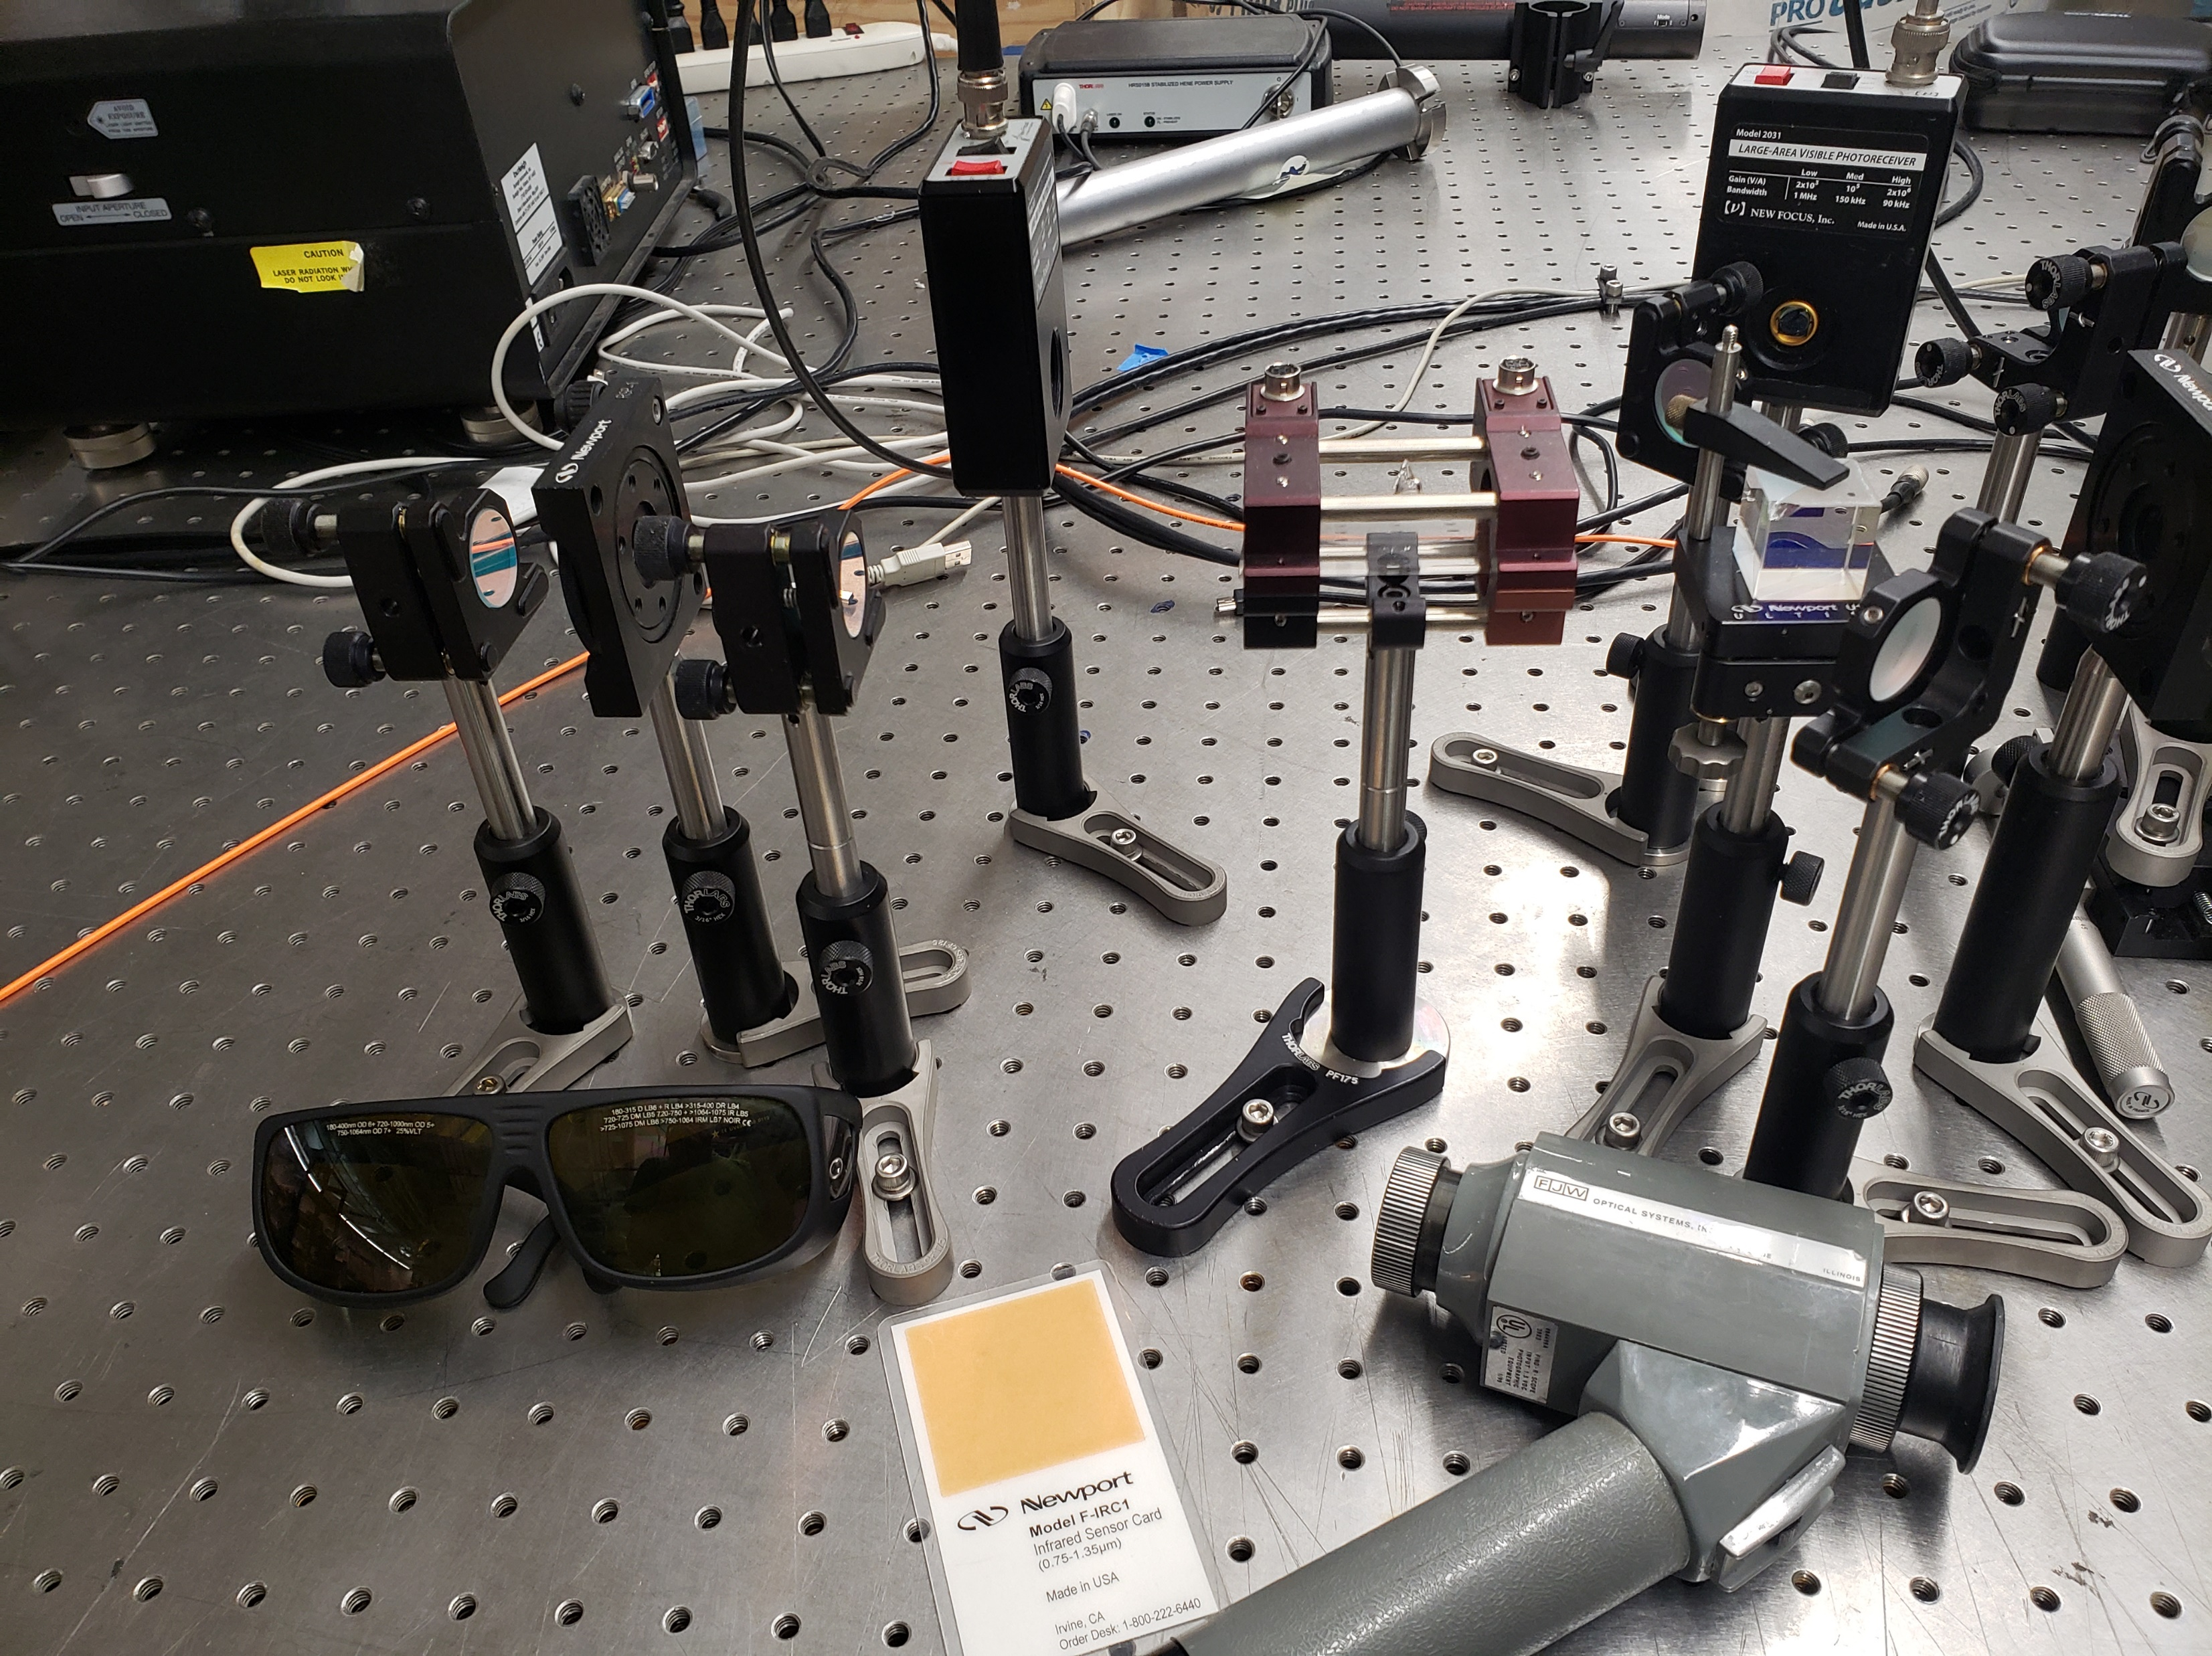
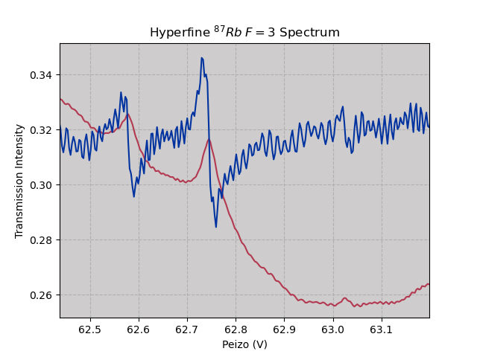
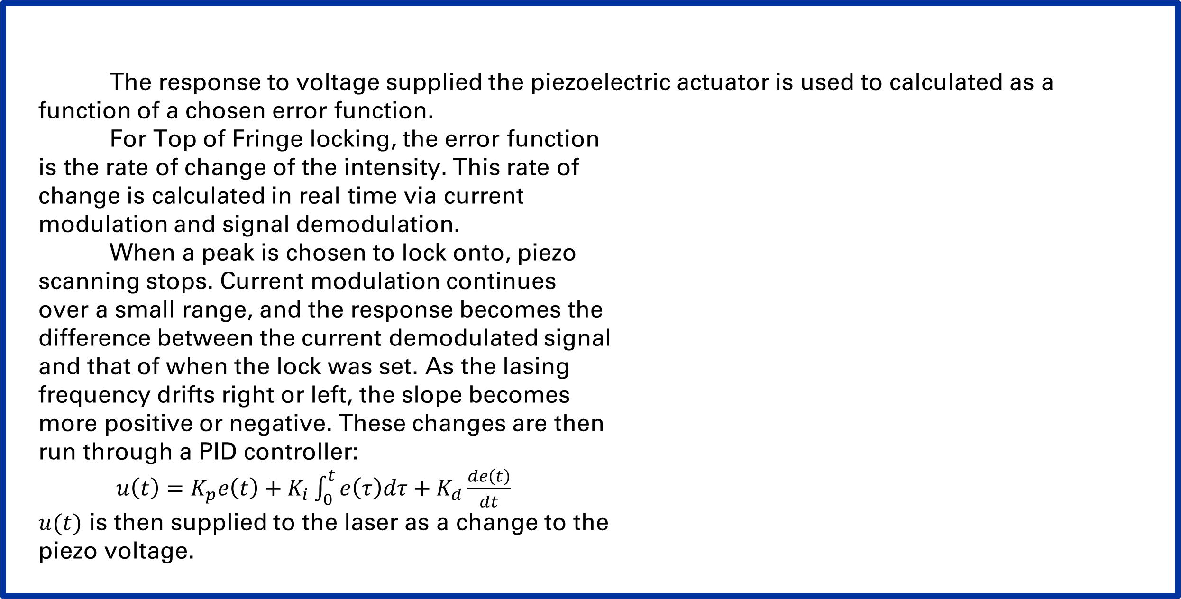
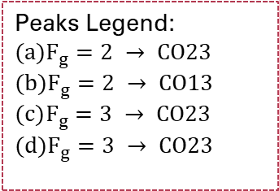
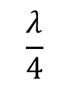
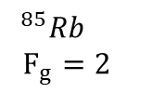


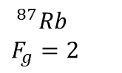
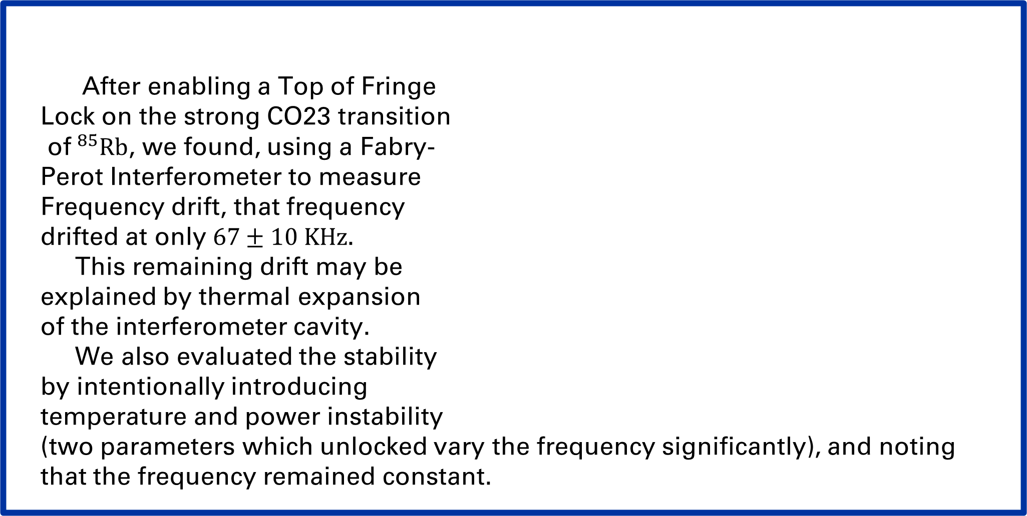
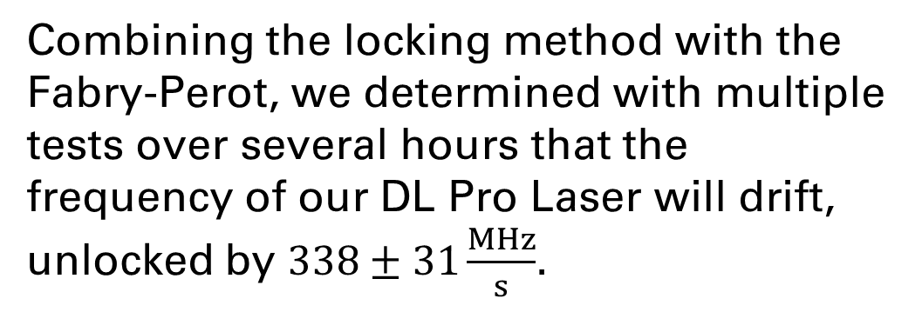
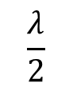
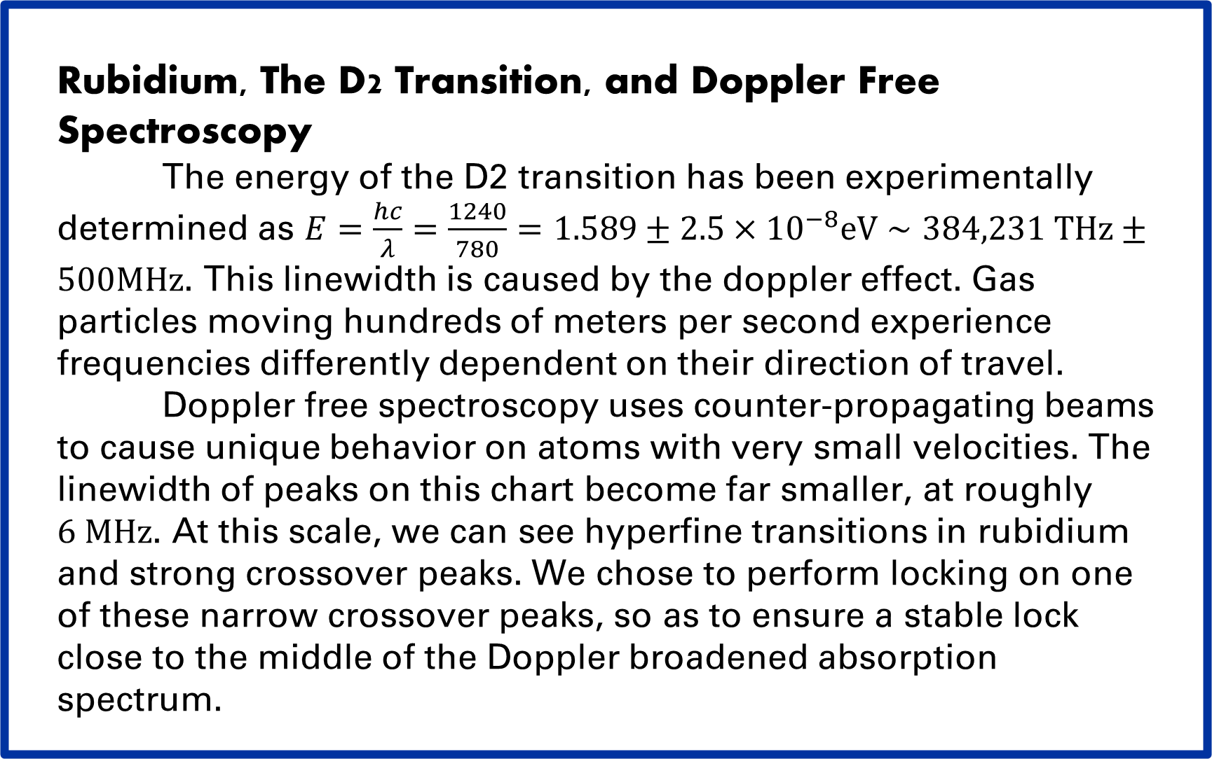
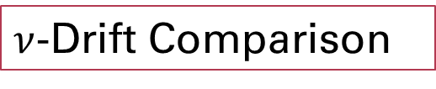

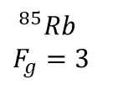
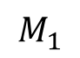
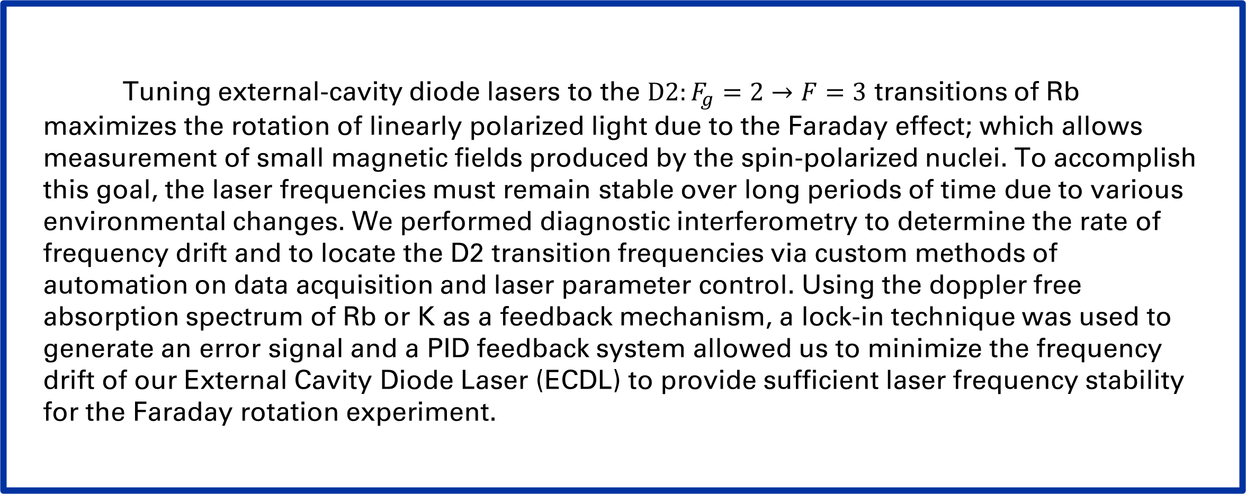
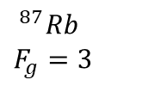

Frequency Stabilization of External Cavity Diode Lasers
$Will {Bodron}^{1}$, $Charlotte {Zehnder}^{2}$
Department of Arts and Sciences, University of Kentucky
Research Mentors: Dr. Wolfgang Korsch
$^{1}$University of Kentucky, KY
$^{2}$Middlebury College, VT
Fabry-Perot Experimental Design
Fiber Optic Couplers and Polarizing
Abstract
Methods
Tuning external-cavity diode lasers to the $D2:F_{g}=2→F=3$ transitions of Rb maximizes the rotation of linearly polarized light due to the Faraday effect; which allows measurement of small magnetic fields produced by the spin-polarized nuclei. To accomplish this goal, the laser frequencies must remain stable over long periods of time due to various environmental changes. We performed diagnostic interferometry to determine the rate of frequency drift and to locate the D2 transition frequencies via custom methods of automation on data acquisition and laser parameter control. Using the doppler free absorption spectrum of Rb or K as a feedback mechanism, a lock-in technique was used to generate an error signal and a PID feedback system allowed us to minimize the frequency drift of our External Cavity Diode Laser (ECDL) to provide sufficient laser frequency stability for the Faraday rotation experiment.
Rubidium, The D2 Transition, and Doppler Free Spectroscopy
The energy of the D2 transition has been experimentally determined as $E=\frac{hc}{λ}=\frac{1240}{780}=1.589±2.5×{10}^{−8}eV∼384,231 THz±500MHz$. This linewidth is caused by the doppler effect. Gas particles moving hundreds of meters per second experience frequencies differently dependent on their direction of travel.
Doppler free spectroscopy uses counter-propagating beams to cause unique behavior on atoms with very small velocities. The linewidth of peaks on this chart become far smaller, at roughly $6 MHz$. At this scale, we can see hyperfine transitions in rubidium and strong crossover peaks. We chose to perform locking on one of these narrow crossover peaks, so as to ensure a stable lock close to the middle of the Doppler broadened absorption spectrum.
$$M_{1}$$
$$\frac{λ}{4}$$
Quantifying $ν$-Drift
Evacuated Rb Cell
Shining light through a scanning Fabry-Perot interferometer and evaluating the phase shift of the timing of the flashes coming through gave us a qualitative measure of the drift.
From the length of the cavity, one can find the spacing between constructive interference peaks. The length of our cavity corresponds with a resonance of 1.5 GHz. With this as a metric, we can quantifiably determine distances through frequency space.
DL pro
Near Infrared light:
$$\frac{λ}{2}$$
Polarizing Beam Splitter
Fabry-Perot Interferometer
Toptica
$$760 nm<λ< 800 nm$$
$$Power< 60 mW$$
Combining the locking method with the Fabry-Perot, we determined with multiple tests over several hours that the frequency of our DL Pro Laser will drift, unlocked by $338±31\frac{MHz}{s}$.
Motivation
Hyperfine $Rb$ Spectrum
PD Voltage (V)
Various components within the laser itself have minimal coefficients of thermal expansion. Humidity, pressure, power supply, and mechanical vibrations also change the conditions within the laser cavity inciting problematic frequency drift.
While tuning to a Rb transition can be done simply with an IR camera and sweeping through a range of the laser’s control parameters until the evacuated Rb Cell cylinder starts to glow infrared, that transition can be totally lost within about an hour. We want to avoid this for the longer Faraday rotation experiments where remaining on transition is imperative.
$$^{87}Rb$$
$$F_{g}=2$$
$$^{85}Rb$$
$$F_{g}=3$$
$$^{85}Rb$$
$F_{g}=2$
$$^{87}Rb$$
$$F_{g}=3$$
Peaks Legend:
$F_{g}=2 → CO23$
$F_{g}=2 → CO13$
$F_{g}=3 → CO23$
$F_{g}=3 → CO23$
Time
Results
After enabling a Top of Fringe
Lock on the strong CO23 transition
of$^{85}Rb$, we found, using a Fabry-
Perot Interferometer to measure
Frequency drift, that frequency
drifted at only $67±10 KHz$.
This remaining drift may be
explained by thermal expansion
of the interferometer cavity.
We also evaluated the stability
by intentionally introducing
temperature and power instability
(two parameters which unlocked vary the frequency significantly), and noting that the frequency remained constant.
DLC pro Controller
$ν$-Drift Comparison
Controls: Littrow Grating angle, temperature, and current through active laser medium
Error Function Isolation and PID
The response to voltage supplied the piezoelectric actuator is used to calculated as a function of a chosen error function.
For Top of Fringe locking, the error function
is the rate of change of the intensity. This rate of
change is calculated in real time via current
modulation and signal demodulation.
When a peak is chosen to lock onto, piezo
scanning stops. Current modulation continues
over a small range, and the response becomes the
difference between the current demodulated signal
and that of when the lock was set. As the lasing
frequency drifts right or left, the slope becomes
more positive or negative. These changes are then
run through a PID controller:
$u\left(t\right)=K_{p}e\left(t\right)+K_{i}\int_{0}^{t}{e\left(τ\right)dτ}+K_{d}\frac{de\left(t\right)}{dt}$
$u(t)$ is then supplied to the laser as a change to the
piezo voltage.
Saturated Absorption Experimental Setup
References
[1] Daryl W. Preston. “Doppler-Free Saturated Absorption”. In: New Problems (1996).
[2] Thomas Rieger and Thomas Volz. “Doppler-Free Saturation Spectroscopy”. In: (2002).
Acknowledgements
This material is based upon work supported by the US Department of Energy, Office of Science, Office of Nuclear Physics, under Award Number DE-FG02-99ER41101.

